Slide 1
Module 8
Threads in .NET

Slide 2
Module Objectives
After completing this module you will understand:
What is Multithreading and it’s advantages.
What is Thread lifecycle.
What is meant by Thread priority.
How to create and implement Threads.
What is the use of join() method in Threading.

Slide 3
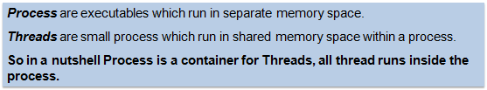
Process verses Thread

Slide 4
Multithreading Introduction
.NET provides built-in support for multithreaded programming.
A multithreaded program contains two or more parts that can run concurrently.
Each part of such a program is called a thread, and each thread defines a separate path of execution.
A multithreading is a specialized form of multitasking. Multithreading requires less overhead than multitasking processing.
A thread cannot exist on its own; it must be a part of a process.

Slide 5



Why is Multithreading needed????

Slide 6
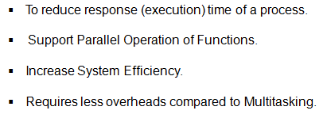
Benefits of Multithreading

Slide 7
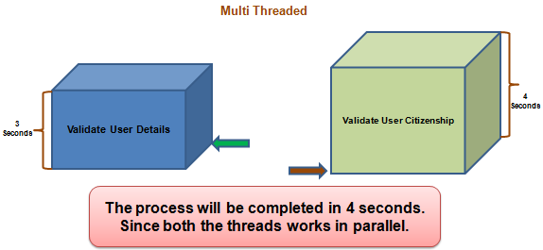
Benefits of Multithreading (cont…)

Slide 8
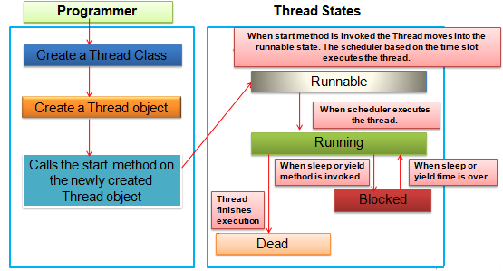
Life Cycle of a Thread

Slide 9
Life Cycle of a Thread (cont….)
New: A new thread begins its life cycle in the new state. It remains in this state until the program starts the thread. It is also referred to as a born thread.
Runnable: After a newly born thread is started, the thread becomes runnable. A thread in this state is considered to be executing its task.
Waiting: Sometimes a thread transitions to the waiting state while the thread waits for another thread to perform a task. A thread transitions back to the runnable state only when another thread signals the waiting thread to continue executing.
.

Slide 10
Life Cycle of a Thread (cont….)
Timed waiting: A runnable thread can enter the timed waiting state for a specified interval of time. A thread in this state transitions back to the runnable state when that time interval expires or when the event it is waiting for occurs.
Terminated: A runnable thread enters the terminated state when it completes its task or otherwise terminates

Slide 11
Thread Priorities
Every .NET thread has a priority that helps the operating system determine the order in which threads are scheduled.
.NET thread priorities are in the range between: Maximum, Minimum, Normal, Above Normal and Below Normal.
Threads with higher priority are more important to a program and should be allocated processor time before lower-priority threads.
However, thread priorities cannot guarantee the order in which threads execute and very much platform dependent.

Slide 12
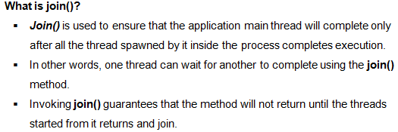
join() in Thread

Slide 13
Thanks

